Slide 1
Specificity/Pleiotropy in FinnGen GWAS studies
26 June 2024

Slide 2
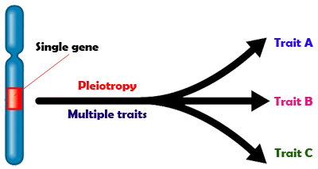
What is pleiotropy?
Single gene influences two or more unrelated traits.

Slide 3


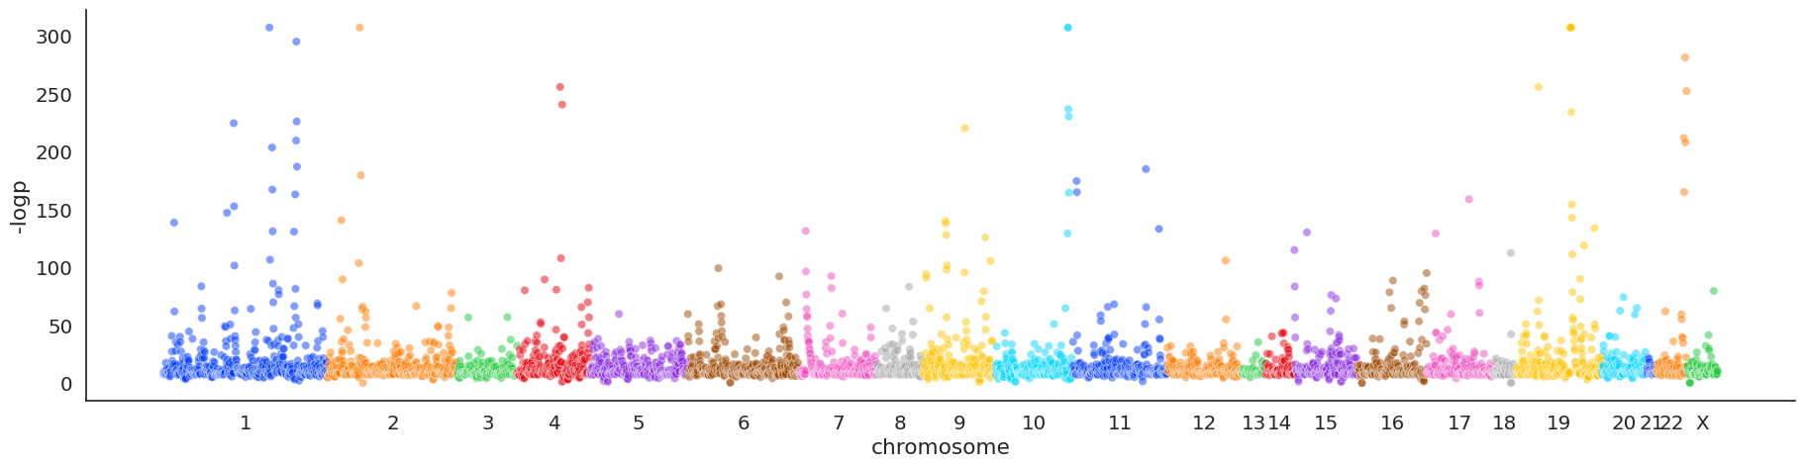
Processing the data
Colocalization of signals
Filter
H4 < 0.8
Coloc table
Coloc table
GWAS Dataset
Cluster based on P-Values of Study Loci
Plot by position
Notes:
MHC and MSH regions excluded.

Slide 4
Processing the data
Filter
H4 < 0.8
Cluster based on P-Values of Study Loci
Coloc table
Coloc table
N = 13,966
N = 10,172
Clusters = 7763
Notes:
MHC and MSH regions excluded. Reduction from original by about 45%

Slide 5
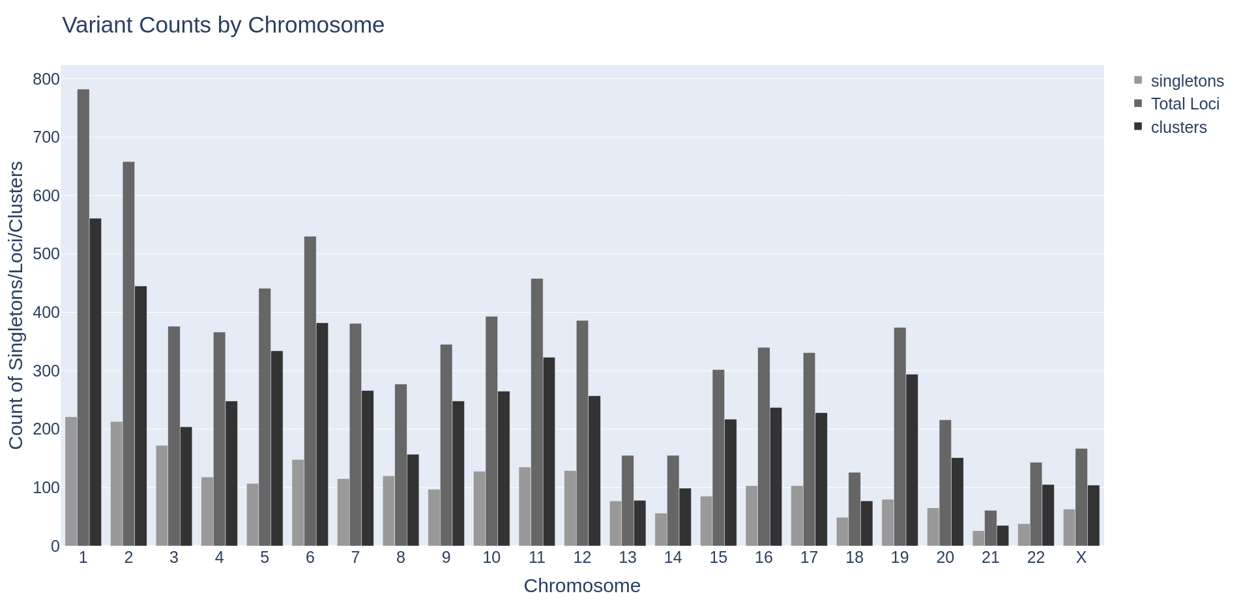
Counts of total study loci/singletons and clusters

Slide 6
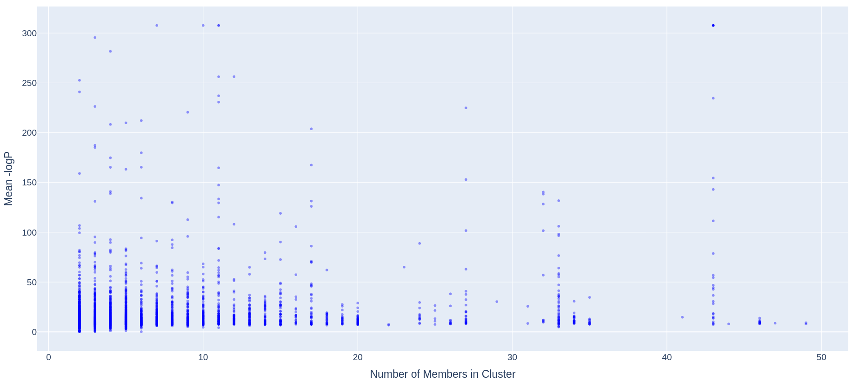
Scatter of P-Value vs Number of members

Slide 7
P-value for lead variant in each cluster

Slide 8
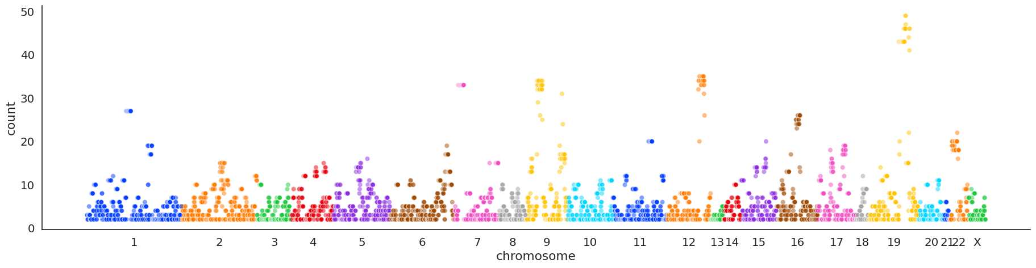
Number of members in each Cluster

Slide 9
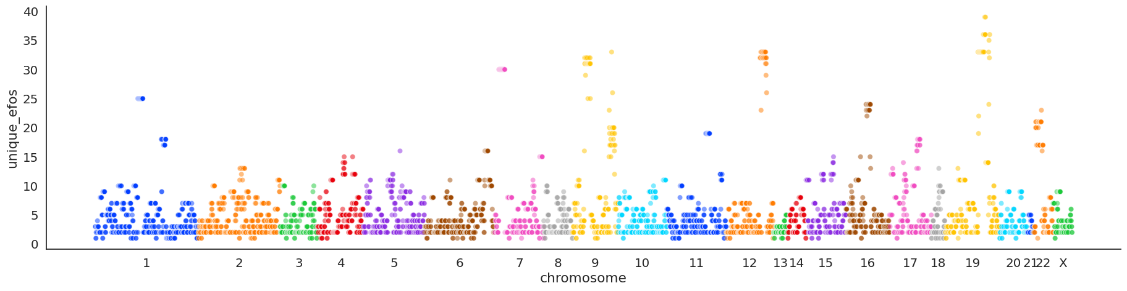
Counts of unique EFO ids (Proxy for pleiotropy) by Cluster

Slide 10
Interesting data points
'Wet age-related macular degeneration', 'Asthma/COPD (KELA code 203)', 'Hard cardiovascular diseases', 'Any dementia (more control exclusions)', 'Pure hypercholesterolaemia', 'Schizophrenia or delusion (more control exclusions)', 'Vascular dementia', 'Alzheimer disease', 'Memory loss', 'Dementia', 'Alzheimer’s disease (undefined) (more control exclusions)', 'Other retinal disorders', 'Vascular dementia (mixed)', 'Metabolic disorders', 'Vascular dementia (subcortical)', 'Alzheimer’s disease (Atypical or mixed) (more control exclusions)', 'Gonarthrosis', 'Heart failure and antihypertensive medication'...

Slide 11
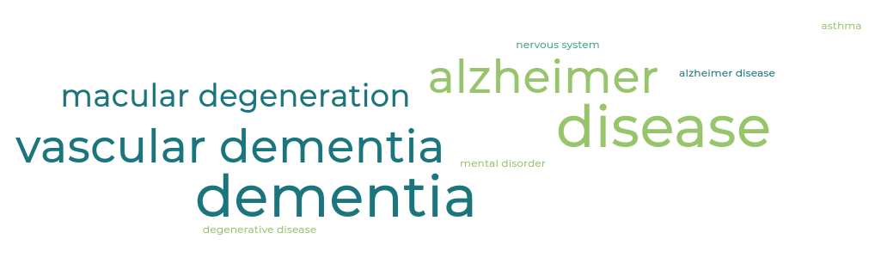
Interesting data points

Slide 12
Interesting data points
"Crohn's disease of large intestine", 'Ankylosing spondylitis', 'Papulosquamous disorders', 'Chronic iridocyclitis', 'Thyrotoxicosis', 'Psoriasis vulgaris', 'Enteropathic arthropathies', 'Other and unspecified psoriasis', 'Other ulcerative colitis', 'Psoriasis', 'Noninfective enteritis and colitis', 'Ulcerative proctitis', 'Subacute thyroiditis', 'Arthropathy in ulcerative colitis', 'Other noninfective gastroenteritis and colitis', 'Ulcerative enterocolitis', 'Mucosal proctocolitis', 'Spondylopathies', 'Spondylopathies (FG)', 'Ulcerative ileocolitis', 'MS-disease / Multiple Sclerosis' …

Slide 13

Interesting data points

Slide 14
Future development
Remove related EFO terms to estimate a better proxy for specificity
Create a quantitative score for specificity
Integrate into gentropy if useful
Link to Locus2Gene Scores.
Investigate any other interesting clusters.

Slide 15
Acknowledgements
Thank you to Yakov for supervising me and all the expert guidance.
Providing technical assistance:
Szymon Szyszkowski
Daniel Considine
And to the rest of the team for their help and welcoming me.

Slide 16
Interesting data points
"Crohn's disease of large intestine", 'Ankylosing spondylitis', 'Papulosquamous disorders', 'Chronic iridocyclitis', 'Thyrotoxicosis', 'Psoriasis vulgaris', 'Enteropathic arthropathies', 'Other and unspecified psoriasis', 'Other ulcerative colitis', 'Psoriasis', 'Noninfective enteritis and colitis', 'Ulcerative proctitis', 'Subacute thyroiditis', 'Arthropathy in ulcerative colitis', 'Other noninfective gastroenteritis and colitis', 'Ulcerative enterocolitis', 'Mucosal proctocolitis', 'Spondylopathies', 'Spondylopathies (FG)', 'Ulcerative ileocolitis', 'MS-disease / Multiple Sclerosis' …

Slide 17
Chromosome | Singletons | Total Study Loci | Total Clusters
1 | 221 | 782 | 561
2 | 213 | 658 | 445
3 | 172 | 376 | 204
4 | 118 | 366 | 248
5 | 107 | 441 | 334
6 | 148 | 530 | 382
7 | 115 | 381 | 266
8 | 120 | 277 | 157
9 | 97 | 345 | 248
10 | 128 | 393 | 265
11 | 135 | 458 | 323
12 | 129 | 386 | 257
13 | 77 | 155 | 78
14 | 56 | 155 | 99
15 | 85 | 302 | 217
16 | 103 | 340 | 237
17 | 103 | 331 | 228
18 | 49 | 126 | 77
19 | 80 | 374 | 294
20 | 65 | 216 | 151
21 | 26 | 61 | 35
22 | 38 | 143 | 105
X | 63 | 167 | 104
Make a quick plot to show this.

